Slide 1




When Transfer Learning Meets Deep Learning
Qiang Yang, HKUST, Hong Kong, China
2017. 11
www.cse.ust.hk/~qyang

Slide 2

What AlphaGo Cannot Do Today?
19x19
21X21

Slide 3
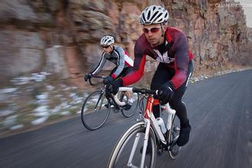
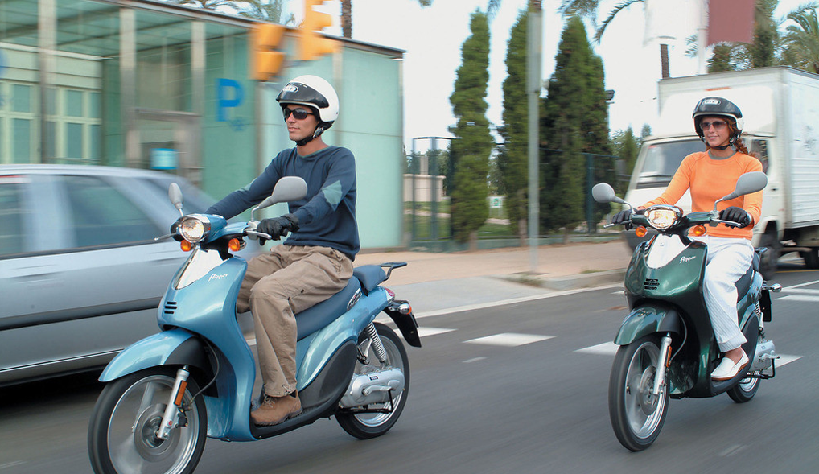
深度学习的迁移模型
迁移学习
迁移学习 Transfer Learning

Slide 4
Next in Machine Learning：迁移学习 Transfer Learning

Slide 5
迁移学习 Transfer Learning

Slide 6
Why Transfer Learning? Small Data

Slide 7
Why Transfer Learning: Reliability
Model
Domain1
Domain2
Domain3
Domain4

Slide 8
Why Transfer Learning? Personalization

Slide 9
Why Transfer Learning is So Hard?

Slide 10
Key to Transfer Learning: Invariant 找出不变量
Driving in Mainland China
Driving in Hong Kong, China

Slide 11
迁移学习 Transfer Learning
Yann LeCun: What is the Thermodynamics of Machine Learning?

Slide 12
Transfer Learning Approaches
Instance-based Approaches
Feature-based Approaches
Parameter/Model -based Approaches
Relational Approaches

Slide 13
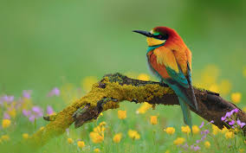
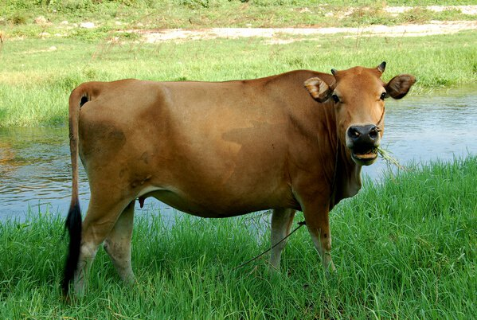
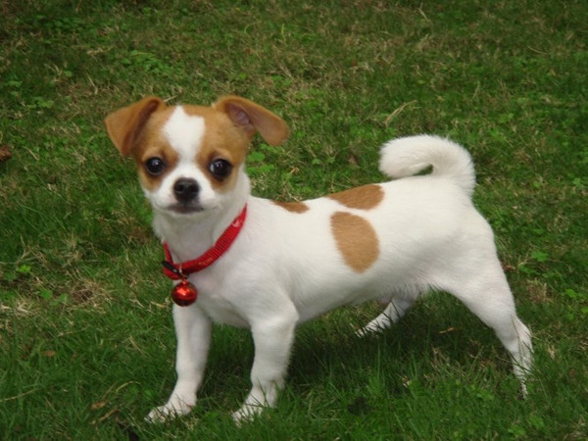
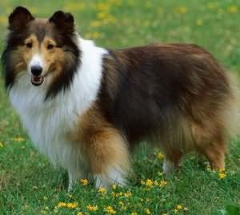
Transfer Learning Method (1): Instance Transfer
Source
Target
Sample 1
Sample 2
Sample 3

Slide 14

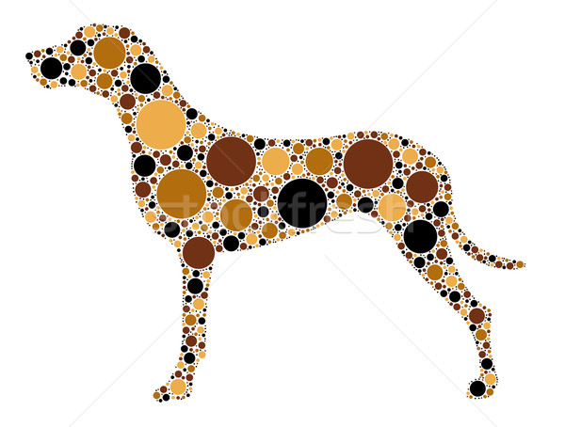

Transfer Learning Method （2）：Feature Transfer
Source
Target
Source (Text)
Target (Images)
梅花香自苦寒来
Shared Features
Images with Text Labels

Slide 15

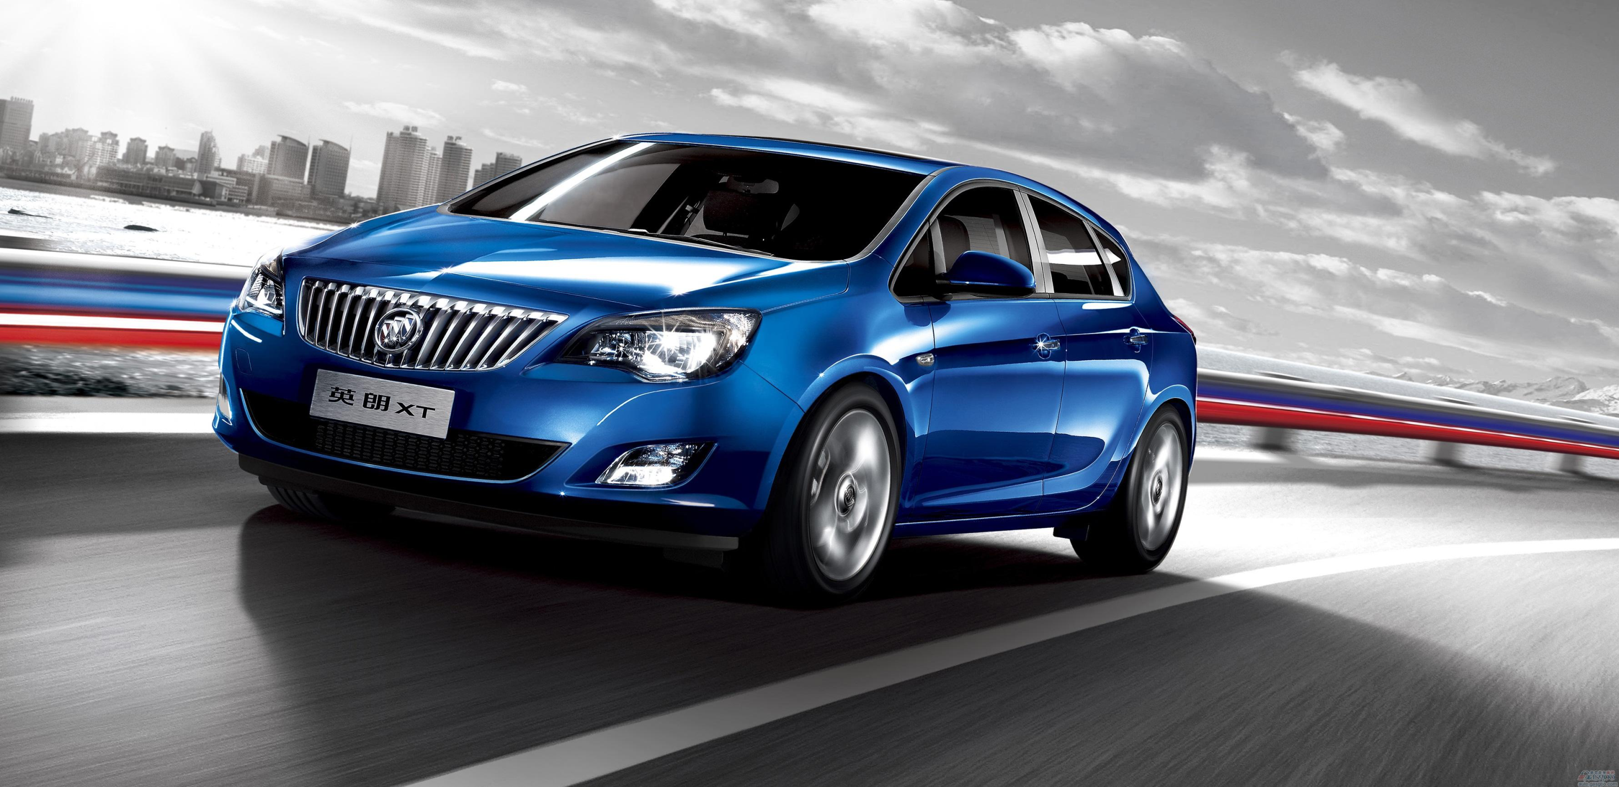
4Paradigm.com:
VIP Account Marketing by Transfer Learning
Micro accounts: > 100 Million
Large accounts <100
Effect: increase by 200%
14

Slide 16
Deep Learning＋Transfer Learning: Multi-layer Feature Learning

Slide 17
Quantitative Analysis of Deep Transfer Learning
input
output
domain distance loss
shared weights
input
output
Bengio, Yoshua, Aaron Courville, and Pascal Vincent. "Representation learning: A review and new perspectives." IEEE transactions on pattern analysis and machine intelligence 35.8 (2013): 1798-1828.
Notes:
Actually the trick of parameter initialization and fine-tune is almost born together with deep learning.
Historically，greedy layer-wise trained DBN and AE[4][5] was used to initialize other tasks, until it is replaced by the dropout and the batch normalization now.
Nowadays, it has become a kind of common practice in many deep learning applications.
The parameters of the layers reflect the learned representation or features by deep learning model, so it is a kind of representation transfer.
But a question remains to be answered, how transferable are the learned features by deep learning?

Slide 18
Deep Transfer Learning: Literature
Accuracy
DDC: Deep Domain Confusion: Tzeng, Eric, Judy Hoffman, Ning Zhang, Kate Saenko, and Trevor Darrell. "Deep domain confusion: Maximizing for domain invariance." arXiv preprint arXiv:1412.3474 (2014).
DAN: Deep Adaptation Networks: Long, Mingsheng, Yue Cao, Jianmin Wang, and Michael Jordan. "Learning transferable features with deep adaptation networks." In International Conference on Machine Learning, pp. 97-105. 2015.
BA: Backpropagation Adaptation: Ganin, Yaroslav, and Victor Lempitsky. "Unsupervised domain adaptation by backpropagation." In International Conference on Machine Learning, pp. 1180-1189. 2015.
70
BA
DDC
DAN
60
CNN
TL with DL
50
TL without DL
40
DL without TL
30
DLID
20
TCA
GFK
10
2011
2012
2013
2014
2015

Slide 19
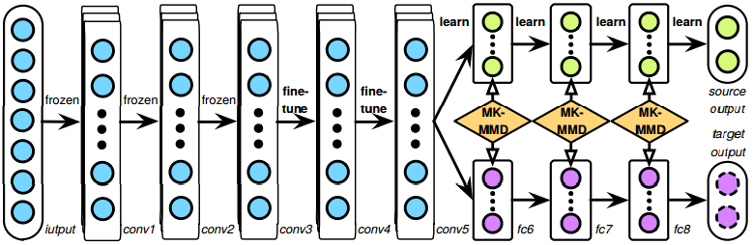
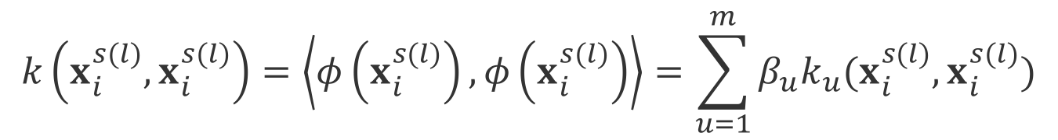
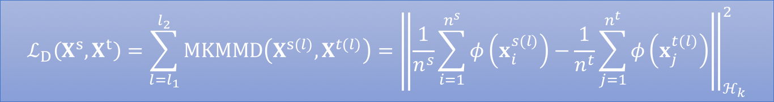

Deep Adaptation Networks (DAN) [Long et al. 2015]
multi-layer adaptation
$$ℒ_{D}\left(X^{s},X^{t}\right)=\sum_{l=l_{1}}^{l_{2}}{MKMMD\left(X^{s(l)},X^{t(l)}\right)}={\left\|\frac{1}{n^{s}}\sum_{i=1}^{n^{s}}{φ\left(x_{i}^{s(l)}\right)}−\frac{1}{n^{t}}\sum_{j=1}^{n^{t}}{φ\left(x_{j}^{t(l)}\right)}\right\|}_{ℋ_{k}}^{2}$$
combination of $m$ PSD kernels
$$k\left(x_{i}^{s(l)},x_{i}^{s(l)}\right)=\left\langle φ\left(x_{i}^{s(l)}\right),φ\left(x_{i}^{s(l)}\right)\right\rangle =\sum_{u=1}^{m}{β_{u}k_{u}(x_{i}^{s(l)},x_{i}^{s(l)})}$$

Slide 20
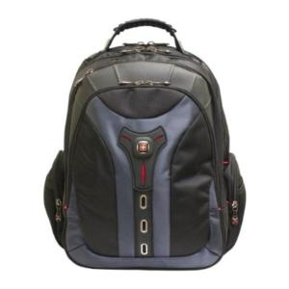

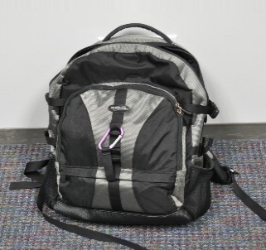
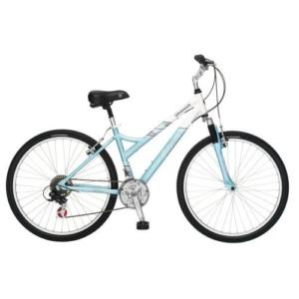
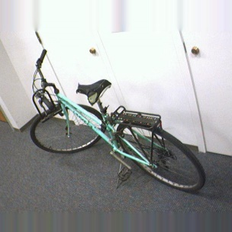
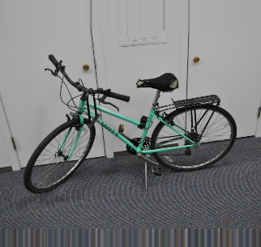
Benchmark Dataset: Office
Description: leverage source images to improve classification of target images
backpack
31 categories
bike
object images in Amazon
low-resolution images taken from a web camera
high-resolution images taken from a digital SLR camera
2,817 images
957 images
795 images
amazon
webcam
dslr
Notes:
Does the combination really improve over (TL with traditional methods) or (DL without TL)? We show a benchmark dataset on which different methods are compared towards the task that leverages …
This Office dataset has 3 domains, i.e., Amazon, Webcam, and DSLR. The 3 domains are different in that pictures in Amazon are object images in Amazon, while Webcam … and DSLR …
There are 31 total categories of objects for all domains, e.g., backpack and bike.
For the domain of Amazon, there are altogether 2,817 images. For Webcam and dslr, …

Slide 21
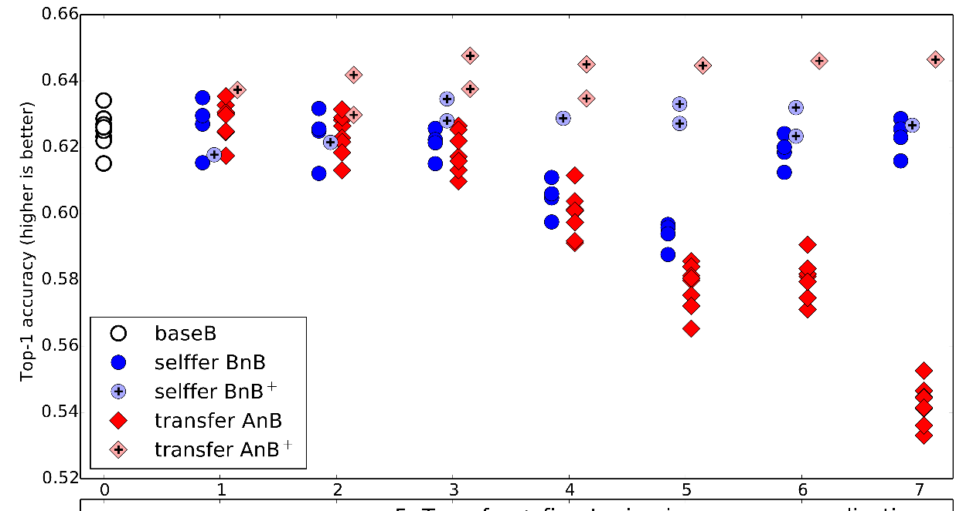
Yosinski, Jason, et al. "How transferable are features in deep neural networks?." NIPS. 2014.
Quantitative Study
ImageNet is not randomly split, but into A = {man-made classes}
B = {natural classes}
[3]
Conclusion 1: lower layer features are more general and transferrable, and higher layer features are more specific and non-transferrable.
Conclusion 2: transferring features + fine-tuning always improve generalization.
What if we do not have any labelled data to finetune in the target domain?
What happens if the source and target domain are very dissimilar?

Slide 22
Transferability of Layer-wise Features
varying four transfer strategies
varying similarity between domains
Conclusions
What if
Fine-tuning with labeled data in a target domain always helps.
No or limited labeled data
Transition from general to specific in a deep neural network.
Performance drops when two domains are very dissimilar.
Two dissimilar domains

Slide 23
Unsupervised Deep Transfer Learning
Goal: learn a classifier in a target domain that is unlabeled and dissimilar to a source domain.
General architecture: Siamese architecture
tied layers
adaptation layers
source classifier
source input
domain distance minimization
target input

Slide 24
Unsupervised Deep Transfer Learning
Objective
$$ℒ=ℒ_{source}+ℒ_{distance}$$
tied layers
adaptation layers
source classifier
source input
domain distance minimization
target input

Slide 25

Unsupervised Deep Transfer Learning
discrepancy loss
Directly minimizes the difference between two domains. [Tzeng et al. 2014, Long et al. 2015, Long et al. 2017]
adversarial loss
Encourages a common feature space through an adversarial objective with respect to a domain discriminator. [Ganin et al. 2015, Tzeng et al. 2015, Liu and Tuzel 2016, Tzeng et al. 2017]
$$ℒ_{distance}$$
reconstruction loss
Combines both unsupervised and supervised training. [Ghifary et al. 2016, Bousmalis et al. 2016]

Slide 26
Discrepancy Based Methods
Source domain’s parameters = Target domain’s parameters
Overall objective
$$ℒ=ℒ_{C}(X^{s},y^{s})+ℒ_{D}(X^{s},X^{t})$$
source domain classification loss
domain distance loss
method | where to adapt | distance between | distance metric
Tzeng et al. 2014 | a specific layer | marginal distributions | Maximum Mean Discrepancy (MMD)
Long et al. 2015 | multiple layers | marginal distributions | Multi-kernel MMD (MK-MMD)
Long et al. 2017 | multiple layers | joint distributions | Joint Distribution Discrepancy (JDD)

Slide 27
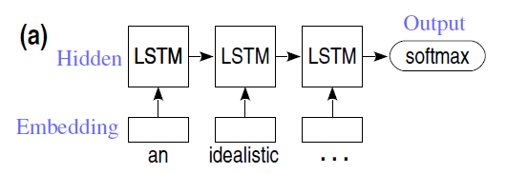
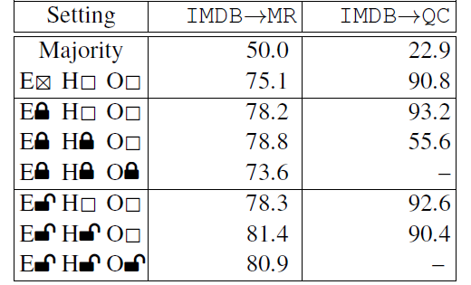
Similarly in RNN for NLP
Lili Mou, Zhao Meng, Rui Yan, Ge Li, Yan Xu, Lu Zhang, and Zhi Jin. How transferable are neural networks in NLP applications? In EMNLP 2016

Slide 28
语音识别中的迁移学习： 口音迁移
Yue Zhao, Yan M. Xu, Mei J. Sun, Xiao N. Xu, Hui Wang, Guo S. Yang, Qiang Ji: Cross-language transfer speech recognition using deep learning. ICCA 2014

Slide 29
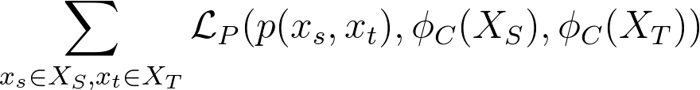
Multimodal Transfer Deep Learning with Applications in Audio-Visual Recognition,Seungwhan Moon, Suyoun Kim, Haohan Wang, arXiv:1412.3121
reconstruction layer
input
common
source domain
Paired loss
input
target domain
reconstruction layer

Slide 30
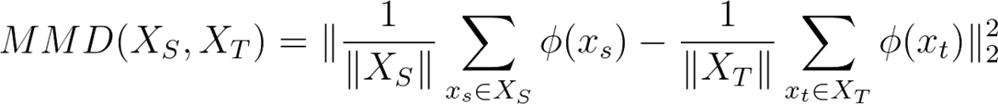

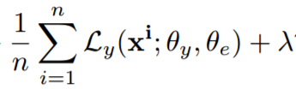
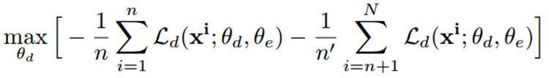
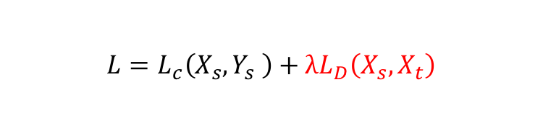
Regularization
1. Determinative Distance MMD
2. Learn to align: fool the domain classifier
  Reverse Gradient: reverse the domain classifier gradient for CNN[7] and RNN[8] representation layers
  ADDA[9]: Alternatively Optimize Domain classifier layer or the common feature by fixing the other
3. Auxiliary Task Loss
  Clustering[10]: add interpretability and enable zero-shot learning
$$L=L_{c}\left(X_{s},Y_{s} \right)+λL_{D}\left(X_{s}, X_{t}\right)$$
input
output
source domain
Soft Constraints
input
target domain

Slide 31
Transitive Transfer Learning
Ben Tan, Yu Zhang, Sinno Jialin Pan, Qiang Yang: Distant Domain Transfer Learning. AAAI 2017
Ben Tan, Yangqiu Song, Erheng Zhong, Qiang Yang: Transitive Transfer Learning. KDD 2015

Slide 32
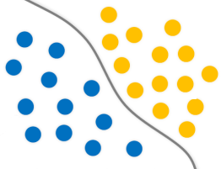

Transitive Transfer Learning
1. A lot of labeled Source Data
Reconstructed Input Data
Unlabeled Intermediate Data
0/1
0/1
3.Some labeled Target Data
Logistic Regression for Labeled Data
Sample Selection for Intermediate and Source Data

Slide 33

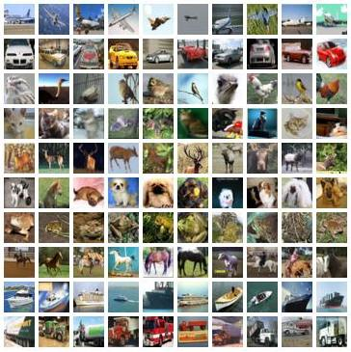
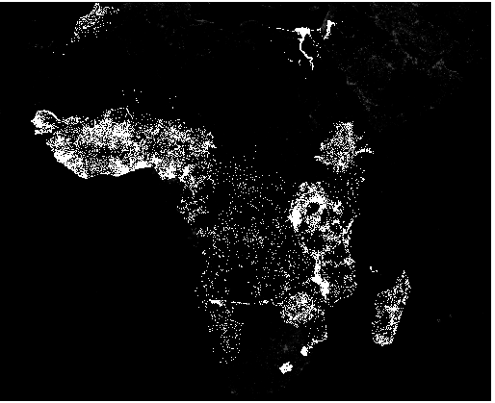
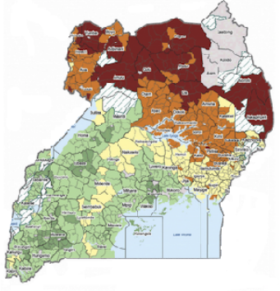
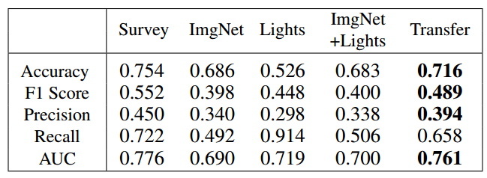
Parameter Initialization + Fine-tune
Transfer Learning for Poverty prediction on satellite image[4]
VGG-Net: initialize the parameter with last domain and then finetune
Closely related
ImageNet
Massive data
Night Light
Less data
Poverty
Scarce data

Slide 34

IJCAI 2017:
End-to-End Adversarial Memory Network for Cross-domain Sentiment Classification
Zheng Li, Yu Zhang, Ying Wei, Yuxiang Wu, Qiang Yang
33
Notes:
Good afternoon, everyone. My name is LI Zheng, from Hong Kong University of Science and Technology. Today, I will introduce my research work, End-to-End Adversarial Memory Network for Cross-domain Sentiment Classification.

Slide 35


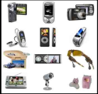

Cross-Domain Sentiment classification
One of the best Crichton novels Sphere by Michael Crichton; excellent novel.
I was disappointed in this book after reading the other stellar reviews.
Test
Training
84%
Sentiment Classifier
Electronics
Electronics
76%
Video
34
Notes:
Unfortunately, effective deep learning methods are highly dependent on large amounts of labeled training. Sometimes we do not have enough or even no labeled data in the target domain. Therefore, cross-domain sentiment classification, which utilizes labeled data from related domains, becomes a promising direction.
The main challenge of cross-domain sentiment classification is the domain discrepancy[dɪs'krep(ə)nsɪ], which may reduce performances of thetask. Fox example, if the source domain and the target domain are both the book domain, the accuracy can achieve 86%, but the if the target domain is restaurant domain, the accuracy can drop to 74%.

Slide 36


Cross-Domain Sentiment Classification: Find Pivots
Electronics
Video Games
(1) Compact; easy to operate; very good picture quality; looks sharp!
(2) A very good game! It is action packed and full of excitement. I am very much hooked on this game.
(3) I purchased this unit from Circuit City and I was very excited about the quality of the picture. It is really nice and sharp.
(4) Very realistic shooting action and good plots. We played this and were hooked.
(5) It is also quite blurry in very dark settings. I will never_buy HP again.
(6) The game is so boring. I am extremely unhappy and will probably never_buy UbiSoft again.
Pivots (domain-shared words): great, nice, never_buy …
35

Slide 37
Existing methods manually select pivots
Structural Correspondence Learning (SCL) [Blitzer et al., 2006]
  Structural Correspondence Learning - Mutual Information (SCL-MI) [Blitzer et al., 2007])
    Mutual information between features and labels (source domain).
  Spectral Feature Alignment (SFA) [Pan et al., 2010])
    Mutual information between features and domains.
Deep learning methods lack the interpretability in identifying pivots.
  Stacked Denoising Autoencoder (SDA) [Glorot et al., 2011]
    Learn by reconstruction.
  Marginalized Stacked Denoising Autoencoder (mSDA) [Chen et al.,2012]:
    Learn by reconstruction.
  Domain-Adversarial Training of Neural Networks (DANN) [Ganin et al., 2016]: Gradient reversal layer.
36
Notes:
Most traditional methods need manually select pivots based on criterions[krai'tiəriən] such as the Term frequency on both domains, Mutual information between features and labels (source domain) and Mutual information between features and domains.

Slide 38
Challenge: automatically identity pivots
Characteristic of pivots:
  important sentiment words for sentiment classification
  domain-shared words
  model: transparent
  Can the attention mechanism in memory network help?
Electronics
Video Games
(1) Compact; easy to operate; very good picture quality; looks sharp!
(2) A very good game! It is action packed and full of excitement. I am very much hooked on this game.
(3) I purchased this unit from Circuit City and I was very excited about the quality of the picture. It is really nice and sharp.
(4) Very realistic shooting action and good plots. We played this and were hooked.
(5) It is also quite blurry in very dark settings. I will never_buy HP again.
(6) The game is so boring. I am extremely unhappy and will probably never_buy UbiSoft again.
37

Slide 39
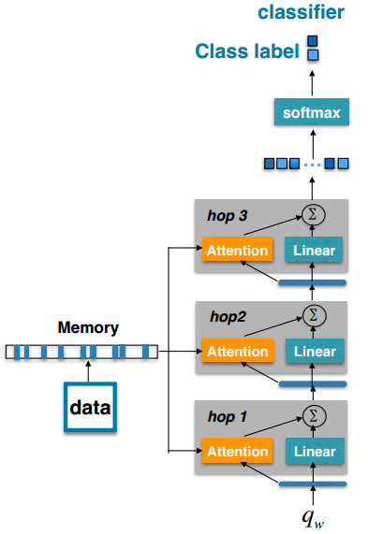

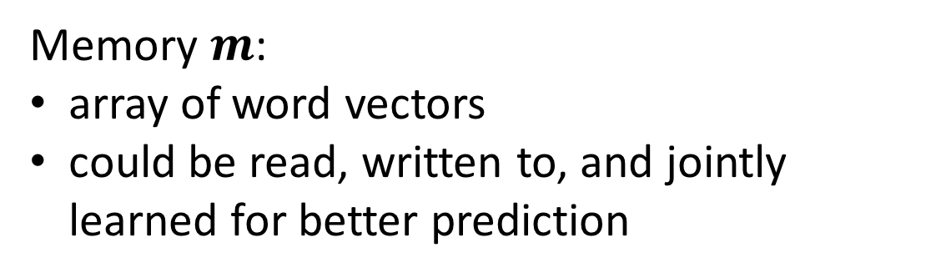
1. Classification using Memory Networks
Memory $m$:
array of word vectors
could be read, written to, and jointly learned for better prediction
Attention :
Each low-level position contributes a different importance weight for a high-level representation
Can capture the corresponding important words according to the task
Can be used for ‘explanation’
$$m$$
Memory network
38
Notes:
Given a document D = {$w_{1},$ $w_{2}$, … $w_{n}$}, we stacked their word vectors and put into the external memory $m$ and the free memories are padded with zero vectors. For the attention layer, we feed the memory vectors into a one-layer MLP and get the hidden representations. The query vector will interact with the hidden representations to get context-aware attentions by masked softmax. Where n is the size of the memory occupied. Lastly, we get the output of attention layer by weighted sum of the memor.

Slide 40


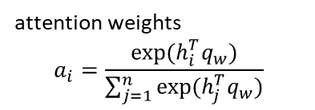








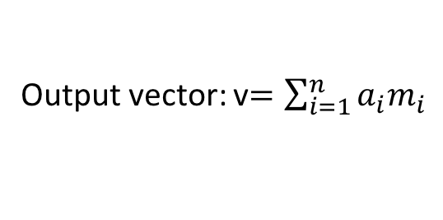




1. Classification with Memory Networks (Cont.)
…
Multi-hops is for extracting more useful words.
Output of the last hop is fed into the classifier.
$$Σ$$
$$r^{2}$$
$$v$$
Output vector: v$=\sum_{i=1}^{n}{a_{i}m_{i}}$
Linear
Softmax
…
Attention:
attention weights
$$a_{i}=\frac{exp⁡(h_{i}^{T}q_{w})}{\sum_{j=1}^{n}{exp⁡(h_{j}^{T}q_{w})}}$$
$$a_{1}$$
$$a_{2}$$
$$a_{n}$$
$$q_{w}$$
$$h_{1}$$
$$h_{2}$$
…
$$h_{n}$$
hidden representations${ h}_{i}$
MLP
$$m$$
$$m_{1}$$
$$m_{2}$$
…
$$m_{n}$$
$\text{external} \text{memory}$:$m∈R^{d×n}$
Great books His characters are engaging
Context vector
randomly initialized and learned during training process.
is used to find words that are useful for the task.
Memory Network
39
Notes:
Given a document D = {$w_{1},$ $w_{2}$, … $w_{n}$}, we stacked their word vectors and put into the external memory $m$ and the free memories are padded with zero vectors. For the attention layer, we feed the memory vectors into a one-layer MLP and get the hidden representations. The query vector will interact with the hidden representations to get context-aware attentions by masked softmax. Where n is the size of the memory occupied. Lastly, we get the output of attention layer by weighted sum of the memor.

Slide 41
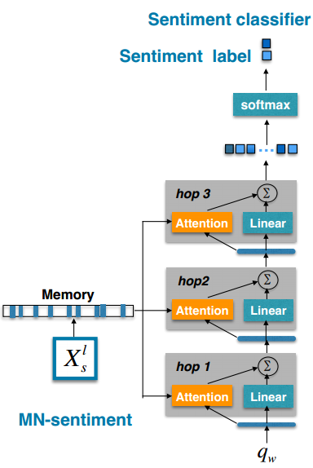

MN-sentiment: Memory Network based Classification
Sentiment Classification:
Objective: Minimize source domain sentiment classification error
Input: source labeled data $X_{s}^{l}$
Electronics
Compact; easy to operate; very good picture quality; looks sharp!
With attention mechanism, MN-sentiment can automatically identify the sentiment words useful for the sentiment classification.
It is also quite blurry in very dark settings. I will never buy HP again.
40
Notes:
We treat the output vector in the last hop of the MN-sentiment as the document representation $v_{s}$ and feed it to the softmax layer for sentiment classification:
The goal of the sentiment classifier is to minimize the cross-entropy for labeled data in the source domain:

Slide 42
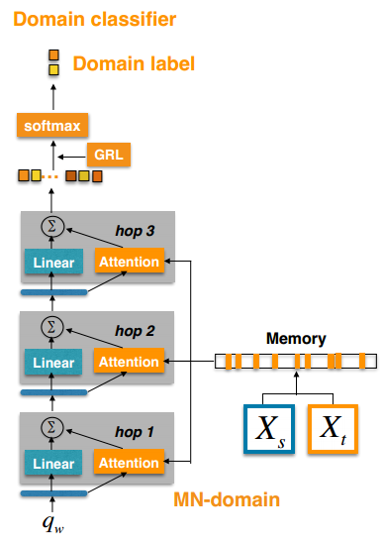
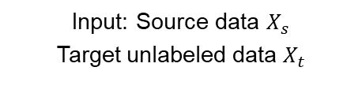


2. Memory Network based Domain Classification
S
T
Domain classification:
Objective: Maximize domain classification error
Domain classifier is optimized to distinguish the samples from the source and target domains.
$$θ_{z}$$
Input: Source data $X_{s}$
Target unlabeled data $X_{t}$
Adversarial
Electronics
S
Compact; easy to operate; very good picture quality; looks sharp!
MN-domain is optimized to make the domain classifier indiscriminative between the samples from the source and target domains
$$θ_{h}$$
Video Games
T
Very realistic shooting action and good plots. We played this and were hooked.
With the attention mechanism, MN-domain can automatically capture the domain-shared words in order to confuse the domain classifier.
41
Notes:
Then, let’s see, our goal is to extract pivots automatically. Pivots have two characteristics. First, they are important sentiment words. Second, They are shared in both domains.
The first memory network named MN-sentiment for .. In order to capture the words with feature1
The second memory network named MN-domain for in order to capture the words with feature 2
These two parameter-shard memory networks , which share all parameters including the query vector
In this way, the query stands for a higher-level representation of ‘what is the pivots’

Slide 43
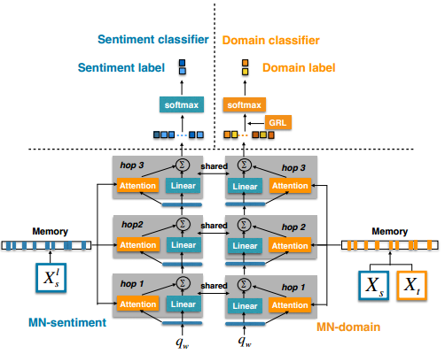

3. Multi-task Learning: Adversarial Memory Network (AMN)
Sentiment Classification
Domain Classification
Input: Source data $X_{s}$
Target unlabeled data $X_{t}$
Input: source labeled data $X_{s}^{l}$
Electronics
Electronics
S
Compact; easy to operate; very good picture quality; looks sharp!
Compact; easy to operate; very good picture quality; looks sharp!
Video Games
It is also quite blurry in very dark settings. I will never_buy HP again.
T
Very realistic shooting action and good plots. We played this and were hooked.
In order to identify the pivots automatically, MN-sentiment & MN-domain share all parameters, and are simultaneously optimized to:
Minimize sentiment classification error in the source domain.
Maximize domain classification error.
42
Notes:
Here is an overview of our model, which mainly consists of four parts. The MN-sentiment, MN-domain, sentiment classifier and domain classifier. The labeled data in the source domain will be feed to MN-sentiment for sentiment classification. All data including labeled data and unlabeled data from the source and target domains will be feed to MN-domain for domain classification.

Slide 44
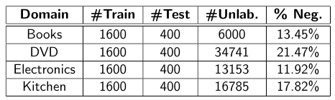
Empirical Tests: Books, DVD, Electronics and Kitchen
Amazon multi-domain review dataset
Table: Statistics of the Amazon reviews dataset including the number
of training, testing, and unlabeled reviews for each domain as well as the portion of negative samples in the unlabeled data.
43

Slide 45
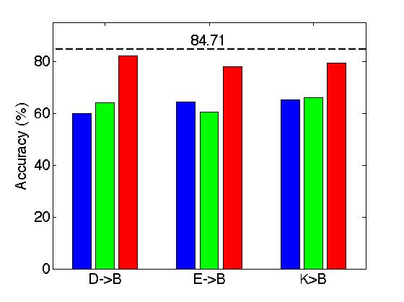
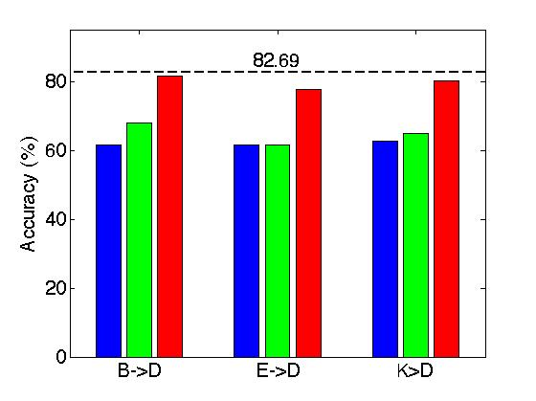
Comparison with Manual Pivot Selection:
SCL [Blitzer 2006] and SFA [Pan 2010]
SFA
  SCL: Structural Correspondence Learning [Blitzer et al., 2006]
  SFA: Spectral Feature Alignment [Pan et al., 2010]
SCL
AMN
Cross-domain sentiment classification results on Amazon Reviews Dataset
44

Slide 46
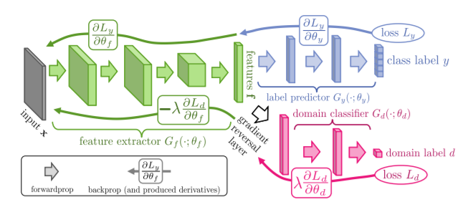
Other Deep Learning based Methods
DANN [Ganin et al., 2016]:
  Discrete representations, such as bag-of-n-grams.
  Lack of interpretability of identify pivots.
DANN + mSDA [Chen et al.,2012]:
  Very high-dimensional representations, up to 30000.
  Low speed.
Our Method:
  Distributed representations, such as word embedding.
  Improve the interpretability by automatically identify pivots with attention mechanism.
Ganin, Yaroslav, et al. "Domain-adversarial training of neural networks." Journal of Machine Learning Research 17.59 (2016): 1-35.
45
Chen, Minmin, et al. "Marginalized denoising autoencoders for domain adaptation." arXiv preprint arXiv:1206.4683 (2012).
Notes:
For DSN, the gan loss is applied to L_{similarity}

Slide 47
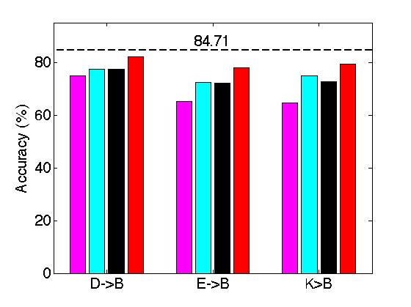
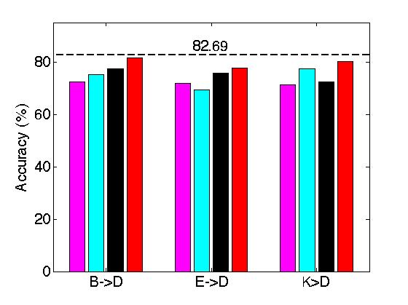
Comparison with Existing Deep-learning Methods
Deep learning methods based on adversarial training:
  DANN: Domain-Adversarial Training of Neural Networks [Ganin et al., 2016]
  DAmSDA: DANN [Ganin et al., 2016] + mSDA [Chen et al.,2012]
  DACNN: DANN [Ganin et al., 2016] + CNN [Kim, 2014]
DANN
DAmSDA
DACNN
AMN
46

Slide 48
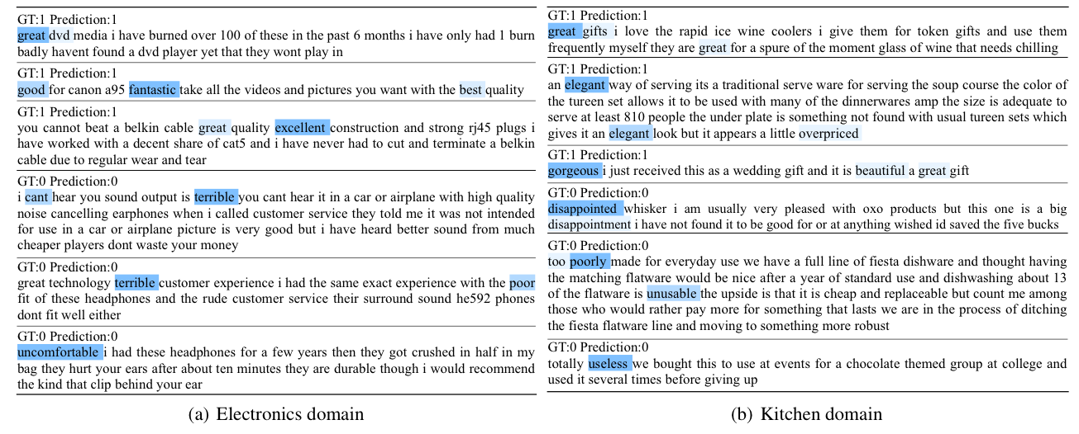
Visualization of Attention
47
Notes:
We have visualized the attention for reviews between different domains. Fox example, the source domain is electronics and target domain is kitchen,
We can see our model can attend to the pivots between different doamins.

Slide 49
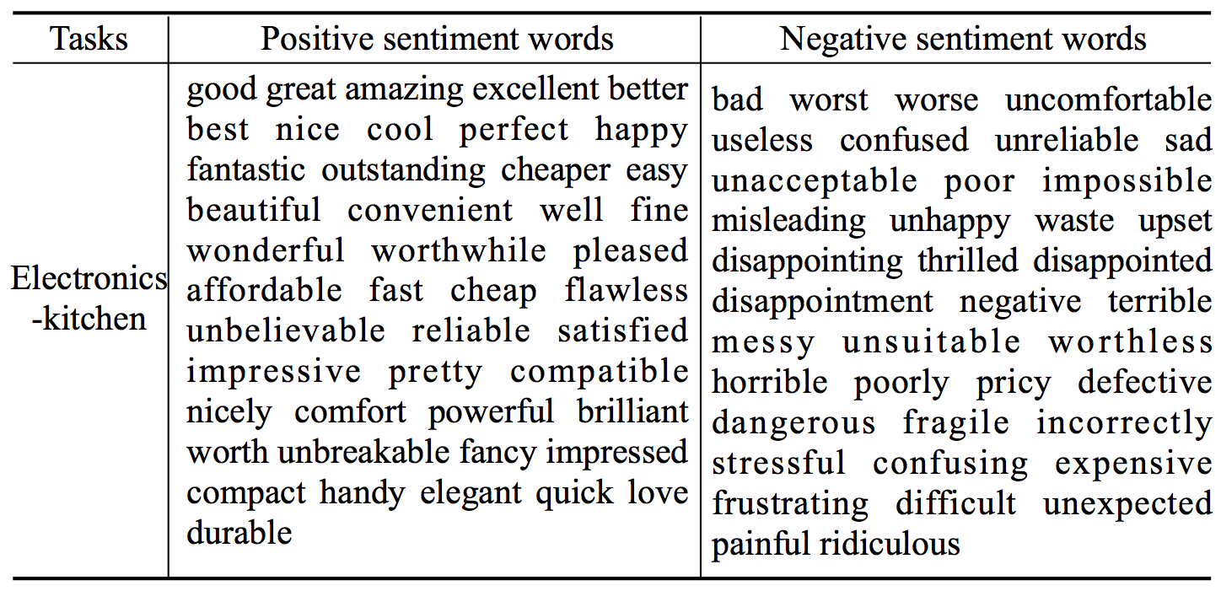
Visualization of Attention
Figure 8: Samples of pivots captured by AMN in the E->K task.
48
Notes:
There are samples of pivots captured by our model in the E-K tasks

Slide 50


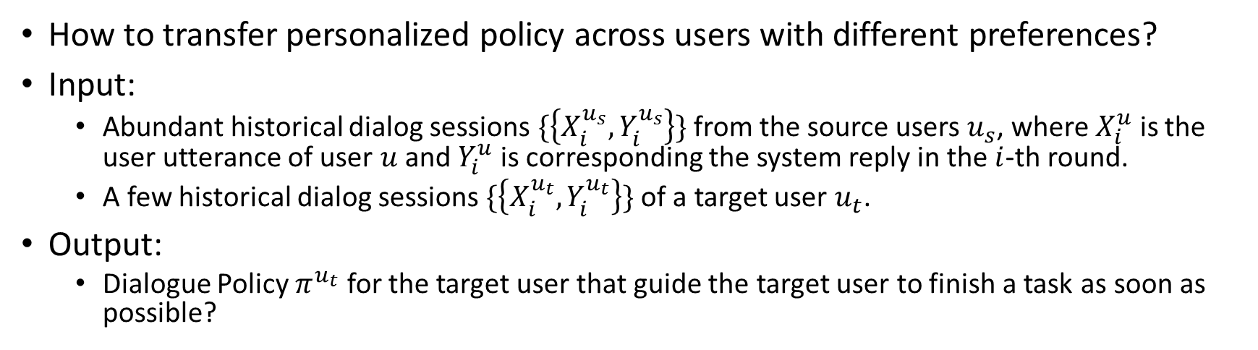
Learning Common Dialogue States and Personalized Q-function
How to transfer personalized policy across users with different preferences?
Input:
  Abundant historical dialog sessions $\{\left\{X_{i}^{u_{s}},Y_{i}^{u_{s}}\right\}\}$ from the source users $u_{s}$, where $X_{i}^{u}$ is the user utterance of user $u$ and $Y_{i}^{u}$ is corresponding the system reply in the $i$-th round.
  A few historical dialog sessions $\{\left\{X_{i}^{u_{t}},Y_{i}^{u_{t}}\right\}\}$ of a target user $u_{t}$.
Output:
  Dialogue Policy $π^{u_{t}}$ for the target user that guide the target user to finish a task as soon as possible?
Many source user dialogues
with different preference.
[Latte, Mocha, …]
Target users with
limited data
[Macchiato]
Transfer
Notes:
Mathematical definition: Add 1 image to illustrate

Slide 51
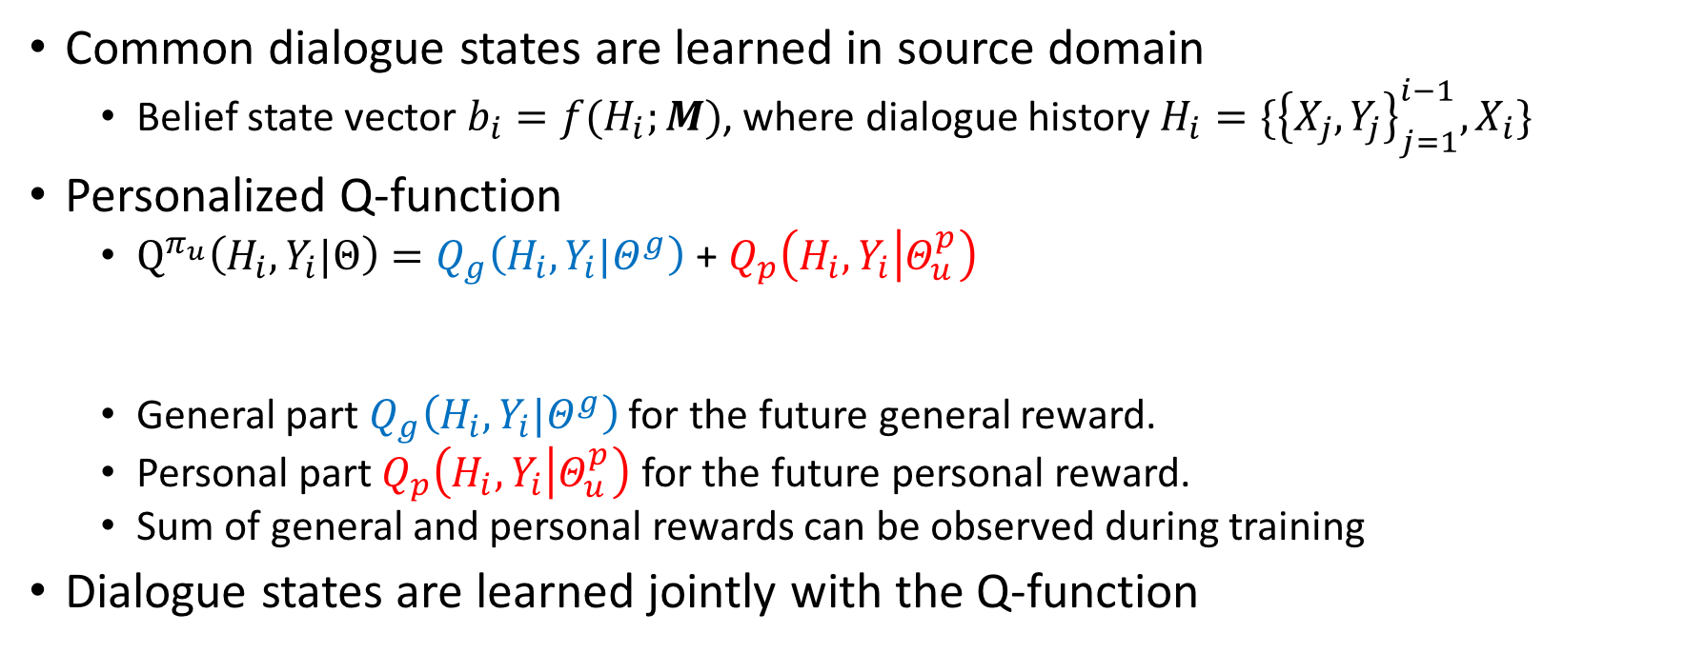
Learning Common Dialogue States and Personalized Q-function
Common dialogue states are learned in source domain
  Belief state vector $b_{i}=f(H_{i};M)$, where dialogue history $H_{i}=\{{\left\{X_{j},Y_{j}\right\}}_{j=1}^{i−1},X_{i}\}$
Personalized Q-function
  $Q^{π_{u}}\left(H_{i},Y_{i}|Θ\right)=Q_{g}\left(H_{i},Y_{i}|Θ^{g}\right)$ + $Q_{p}\left(H_{i},Y_{i} | Θ_{u}^{p}\right)$
  General part $Q_{g}\left(H_{i},Y_{i}|Θ^{g}\right)$ for the future general reward.
  Personal part $Q_{p}\left(H_{i},Y_{i} | Θ_{u}^{p}\right)$ for the future personal reward.
  Sum of general and personal rewards can be observed during training
Dialogue states are learned jointly with the Q-function
General part
Personal part
Notes:
Model overview

Slide 52




Learning Common Dialogue States and Personalized Q-function
Common Belief State model Belief state vector $b_{i}=f(ℋ_{i};M)$
  $M∈ ℝ^{v×d}$ is the state projection matrix
  $v$ is the vocabulary size,, and$d$ is the dimension for sentence embedding
Current user utterance
Last agent reply
User: I want a cup of coffee.
Agent: Same as before? Tall hot macchiato and deliver to No.1199 Mingsheng Road?
User: Iced mocha today.
$$M$$
$$X_{1}$$
$$Y_{1}$$
$$X_{2}$$
$b_{i}=[X_{i−1}^{h},X_{i},Y_{i−2}^{h},Y_{i−1}]$
Sentence Embed Vector
Weighted sum of Agent historical replies
Weighted sum of user historical utterance

Slide 53




Learning Common Dialogue States and Personalized Q-function
$Q^{π_{u}}\left(H_{i},Y_{i}|Θ\right)=Q_{g}\left(H_{i},Y_{i}|Θ^{g}\right)$ + $Q_{p}\left(H_{i},Y_{i} | Θ_{u}^{p}\right)$
$Q_{g}\left(H_{i},Y_{i}|Θ^{g}\right)=Y_{i}W{\left(b_{i}\right)}^{T}$, where $W∈ℝ^{d∗4d}$, $b_{i}$ is the current belief state defined in the previous slide
$$W$$
$$Q_{g}$$
=
$$Y_{i}$$
General Q function models the interaction between state vector and act vector
$${\left(b_{i}\right)}^{T}$$

Slide 54






Learning Common Dialogue States and Personalized Q-function
  Categorical distribution with $p_{u}=\{s_{0}:\left\{Macchiato:0.5,latte:0.5\right\}, s_{1}:\left\{hot:0.9,cold:0.1\right\},$…}
Personal part of the Q-function:
$Q_{p}\left(H_{i}^{u},Y_{i}^{u} | p_{u},w_{p}\right)=w_{p}\sum_{j=1}{f\left(s_{ij}^{u};p_{u}\right)}δ(S_{j},H_{i}^{u})$
$s_{ij}^{u}$ is the slot value of slot j in $Y_{i}^{u}$ $s_{i0}^{u}$: macchiato
$s_{i1}^{u}:$ hot
=1.5*(0.5*1.0+0.9*1.0)=2.1
$$Q_{p}$$
$S_{j}$ is the j-th slot
$S_{0}:$ Coffee
$S_{1}:$ Temperature
User: I want a cup of coffee.
Reply Candidates | Personal Q-function
Same as before? Hot macchiato?? (2 suitable values detected for the target user) | +2.1
Personal weight learned in target domain training data.
Larger value means the user has stable preference.
Is this info type $S_{j}$ first mentioned
in this system reply?
$δ\left(S_{0},H_{i}^{u}\right)=1.0$, $δ\left(S_{1},H_{i}^{u}\right)=1.0$
since it is the first recommendation
of coffee type and temperature.
Notes:
This is a function C(;) and slot C_j. It is confusing.

Slide 55

Learning Common Dialogue States and Personalized Q-function
Q-learning
  $L\left(Θ\right)=E[{\left(r_{i}+λ\max_{𝒜_{i+1}}Q\left(H_{i+1},Y_{i+1}|Θ\right)−Q(H_{i},Y_{i}|Θ)\right)}^{2}]$
Learning Algorithm
  Step1: Learning common dialogue states and Q-function from source domain
    Learn the $Q_{g}\left(H_{i},Y_{i}|Θ^{g}\right)$ + $Q_{p}\left(H_{i},Y_{i} | Θ_{u}^{p}\right)$ in source domain, where $Q_{g}$ is retained and $Q_{p}$ is discarded.
  Step2: Learn personalized Q-function for target user
    $Q_{g}\left(ℋ_{i},𝒜_{i}|Θ^{g}\right)$ is transferred from source domain
    The personal Q-function part $Q_{p}\left(ℋ_{i},𝒜_{i} | Θ_{u}^{p}\right)$ is learned from target domain

Slide 56



Real-world Experiment
Dialogue
history
$$H_{2}$$
$X_{1}$:需要一杯星巴克中杯拿铁
$Y_{1}$ :拿铁(中杯)；请问冰的还是热的？送到 海淀大街34号海置创投大厦5层 对吧，配送费每单5元起
$X_{2}$ :现在有配送费啦？[$r_{1}$]
Candidate Reply Set
$Y_{c1}$: * 一直都有呀 (Ground Truth Human Reply1)
$Y_{c2}$: 请问想喝什么？(Randomly sampled Reply2)
$Y_{c3}$: 拿铁没有冷的。(Randomly sampled Reply2)
Evaluation: AUC (Williams and Zweig 2016)
  For each dialogue round
    The ground truth human reply, label=1.
    Randomly sample 10 replies, label=0.
    The dialogue policy will output a score for each candidate.
    The AUC for this turn is calculated.
 | Source Domain |  | Target Domain
 | Users | Dialogues | Users | Dialogues
Real Data | 52 | 1859 | 20 | 329
Simulation | 11 | 176000 | 5 | 100
[Williams and Zweig 2016] Williams, J. D., and Zweig, G.2016. End-to-end LSTM-based dialog control optimized with supervised and reinforcement learning. arXiv preprint arXiv:1606.01269

Slide 57

Real-world Experiment
Setting: Coffee ordering
  Common Dialogue Knowledge is transferred from source domain to target domain.
  Ranking ground true human reply among random replies.
  Evaluation: AUC
AUC of Ranking
 | Source Domain |  | Target Domain
 | Users | Dialogues | Users | Dialogues
Real Data | 52 | 1859 | 20 | 329
Simulation | 11 | 176000 | 5 | 100

Slide 58


Simulation Experiment
User Simulator
  Order coffee according to preference
Evaluation: Averaged Reward, Success Rate and Dialogue Length
  Source: Model is trained with 176000 dialogues from 11 source user simulators with/without preference
  Adapt: adapt on total 100 dialogues from 5 target test user.
  Test: 5 target users with fixed preference will order coffee for 1000 rounds.
  Success rate is the probability of the user finishing the dialogue within 20 dialogue rounds.
Success Rate, higher is better
Dialogue Length, lower is better
Notes:
Simply define the success rate

Slide 59


Simulation Case Study
Baseline
PETAL: Personalized POMDP
Reduced Length!

Slide 60
Summary
Machine Learning: Learn from Data
Transfer Learning: Adapt from Learned Models
Transfer Learning + Deep Learning:
  Learning based on the separation of feature granularity, layers of granularity
  Transfer both features and instances by multi-task learning

